Slide 1
Module 15: Cryptographic Services
Instructor Materials
Networking Security v1.0
(NETSEC)
Notes:
Networking Security (NETSEC) Module 15: Cryptographic Services

Slide 2
Instructor Materials – Module 15 Planning Guide
This PowerPoint deck is divided in two parts:
Instructor Planning Guide
Information to help you become familiar with the module
Teaching aids
Instructor Class Presentation
Optional slides that you can use in the classroom
Begins on slide # 10.
Note: Remove the Planning Guide from this presentation before sharing with anyone.
For additional help and resources go to the Instructor Home Page and Course Resources for this course. You also can visit the professional development site on netacad.com, the official Cisco Networking Academy Facebook page, or Instructor Only FB group.

Slide 3
What to Expect in this Module
To facilitate learning, the following features within the GUI may be included in this module:
Feature | Description
Animations | Expose learners to new skills and concepts.
Videos | Expose learners to new skills and concepts.
Check Your Understanding(CYU) | Per topic online quiz to help learners gauge content understanding.
Interactive Activities | A variety of formats to help learners gauge content understanding.
Syntax Checker | Small simulations that expose learners to Cisco command line to practice configuration skills.
PT Activity | Simulation and modeling activities designed to explore, acquire, reinforce, and expand skills.

Slide 4
What to Expect in this Module (Cont.)
To facilitate learning, the following features may be included in this module:
Feature | Description
Hands-On Labs | Labs designed for working with physical equipment.
Class Activities | These are found on the Instructor Resources page. Class Activities are designed to facilitate learning, class discussion, and collaboration.
Module Quizzes | Self-assessments that integrate concepts and skills learned throughout the series of topics presented in the module.
Module Summary | Briefly recaps module content.

Slide 5
Check Your Understanding
Check Your Understanding activities are designed to let students quickly determine if they understand the content and can proceed, or if they need to review.
Check Your Understanding activities do not affect student grades.
There are no separate slides for these activities in the PPT. They are listed in the notes area of the slide that appears before these activities.
Notes:
5

Slide 6
Module 15: Activities
What activities are associated with this module?
Page # | Activity Type | Activity Name | Optional?
15.0.3 | Lab | Creating Codes | Recommended
15.1.5 | Check Your Understanding | Identify the Secure Communication Objective | Recommended
15.3.4 | Check Your Understanding | Crack the Code | Recommended
15.4.4 | Check Your Understanding | Cryptology Terminology | Recommended
15.4.5 | Lab | Exploring Encryption Methods | Recommended
15.5.2 | Module Quiz | Cryptographic Services Quiz | Recommended

Slide 7
Module 15: Best Practices
Prior to teaching Module 15, the instructor should:
Review the activities and assessments for this module.
Try to include as many questions as possible to keep students engaged during classroom presentation.
Topic 15.1
Ask the class “You must secure email traffic between a branch site and the HQ site. What are three things that you would need to implement to secure messages between the sites?” Elicit that they would need to implement:
Confidentiality in case the email was captured and read.
Integrity to ensure that nothing in the email has changed.
Authenticity to ensure that the message came from the other destination.
Notes:
7

Slide 8
Module 15: Best Practices
Topic 15.2
Tell the class that “Cryptography is the development and use of secret codes. Encryption is the common method used in cryptography.”
Ask the class “Encrypt a message on paper between you and a friend. This message should not be decipherable by anyone else other than you and your friend?” Elicit answers and try to relate them to the encryption method and the “key” to solve the encryption.
Topic 15.3
Tell the class that “Cryptanalysis is the breaking of codes without knowing the encryption method or the key. Cryptanalysts use various methods to break codes.”
Ask the class “Attempt to decrypt the message on paper?”
Notes:
8

Slide 9
Module 15: Best Practices
Topic 15.4
Tell the class that “Cryptology is the science of making (cryptography) and breaking (cryptanalysis) of secret code.”
Ask the class “Can anyone tell give me examples of cryptology methods used over the centuries?” Elicit answers.
Tell the class “You locked your bicycle last season with a three-tumbler combination lock and now you cannot remember the 3-digit code.”
Ask the class “How long would it take you to crack the code if you entered every code possible from 000 to 999?” Elicit answers.
Ask the class “What if it were a 4-tumbler lock or a 5-tumbler lock. How long would it take you to crack it?”
Tell the class “As you add tumblers (i.e., digit), the number of possibilities increases ten-fold. This is also how modern encryption algorithms work by using a very large keyspace.”
Notes:
9

Slide 10
Module 15: Cryptographic Services
Networking Security v1.0
(NETSEC)
Notes:
Networking Security (NETSEC) Module 15: Cryptographic Services

Slide 11
Module Objectives
Module Title: Cryptographic Services
Module Objective: Explain how the types of encryption, hashes, and digital signatures work together to provide confidentiality, integrity, and authentication.
Topic Title | Topic Objective
Secure Communications | Explain the requirements of secure communications including integrity, authentication, and confidentiality.
Cryptography | Describe cryptography.
Cryptanalysis | Describe cryptanalysis.
Cryptology | Describe cryptology.
Notes:
11
15 – Cryptographic Services
15.0.2 – What will I learn to do in this module?

Slide 12
15.1 Secure Communications
Notes:
15: Cryptographic Services 15.1: Secure Communications

Slide 13
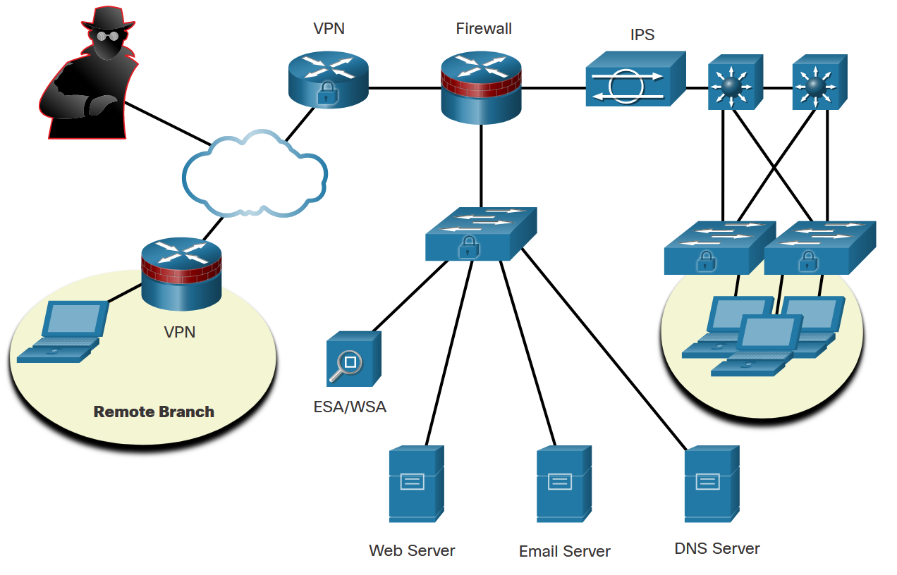
Secure Communications
Authentication, Integrity, and Confidentiality
To ensure secure communications across both the public and private infrastructure, the network administrator’s first goal is to secure the network infrastructure, including routers, switches, servers, and hosts.
The figure shows an example of a secure network topology.
There are three primary objectives of securing communications:
Authentication
Integrity
Confidentiality
Notes:
15: Cryptographic Services 15.1: Secure Communications 15.1.1: Authentication, Integrity, and Confidentiality

Slide 14
Secure Communications
Authentication
There are two primary methods for validating a source in network communications: authentication services and data nonrepudiation services.
In network communications, authentication can be accomplished using cryptographic methods.
Data nonrepudiation is a similar service that allows the sender of a message to be uniquely identified. With nonrepudiation services in place, a sender cannot deny having been the source of that message.
Notes:
15: Cryptographic Services 15.1: Secure Communications 15.1.2: Authentication

Slide 15
Secure Communications
Data Integrity
Data integrity ensures that messages are not altered in transit. With data integrity, the receiver can verify that the received message is identical to the sent message and that no manipulation occurred.
Notes:
15: Cryptographic Services 15.1: Secure Communications 15.1.3: Data Integrity

Slide 16
Secure Communications
Data Confidentiality
Data confidentiality ensures privacy so that only the receiver can read the message. This can be achieved through encryption. Encryption is the process of scrambling data so that it cannot be easily read by unauthorized parties.
When enabling encryption, readable data is called plaintext, or cleartext, while the encrypted version is called encrypted text or ciphertext. The plaintext readable message is converted to ciphertext, which is the unreadable, disguised message. Decryption reverses the process. A key is required to encrypt and decrypt a message. The key is the link between the plaintext and ciphertext.
Using a hash function is another way to ensure data confidentiality. A hash function transforms a string of characters into a usually shorter, fixed-length value or key that represents the original string. The difference between hashing and encryption is in how the data is stored.
Notes:
15: Cryptographic Services 15.1: Secure Communications 15.1.4: Data Confidentiality
15.1.5: Check Your Understanding - Identify the Secure Communication Objective

Slide 17
15.2 Cryptography
Notes:
15: Cryptographic Services 15.2: Cryptography

Slide 18
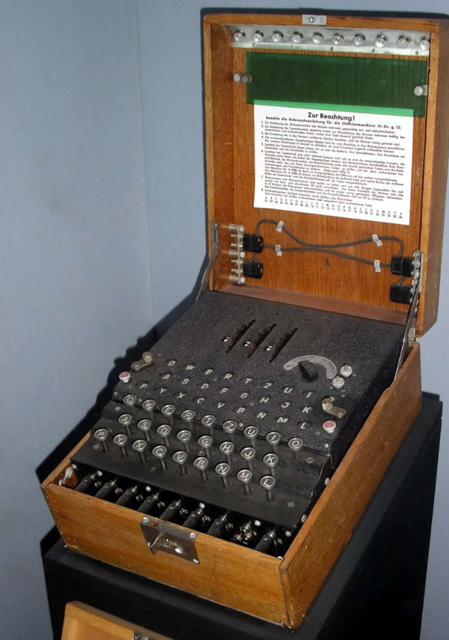
Cryptography
Creating Cipher Text
The history of cryptography starts in diplomatic circles thousands of years ago. Messengers from a king’s court took encrypted messages to other courts. Occasionally, other courts not involved in the communication, attempted to steal messages sent to a kingdom they considered an adversary. Not long after, military commanders started using encryption to secure messages.
The Enigma machine was an electromechanical encryption device that was developed and used by Nazi Germany during World War II. The device depended on the distribution of pre-shared keys that were used to encrypt and decrypt messages. The figure is an example of an Enigma machine.
Notes:
15: Cryptographic Services 15.2: Cryptography 15.2.1: Creating Cipher Text

Slide 19
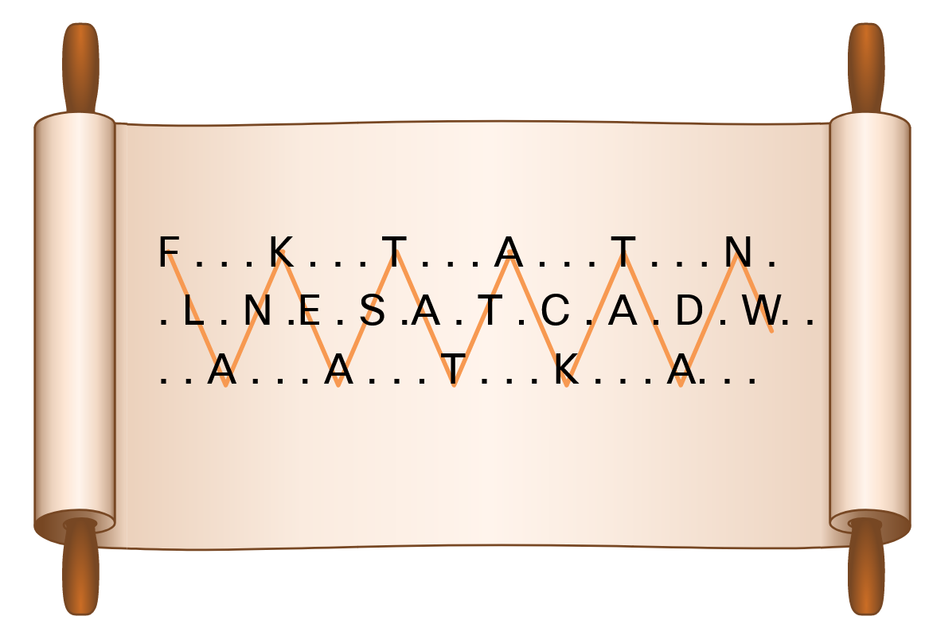
Cryptography
Transposition Ciphers
In transposition ciphers, no letters are replaced; they are simply rearranged. An example of this type of cipher is taking the FLANK EAST ATTACK AT DAWN message and transposing it to read NWAD TA KCATTA TSAE KNALF. In this example, the key is to reverse the letters.
Another example of a transposition cipher is known as the rail fence cipher. In this transposition, the words are spelled out as if they were a rail fence. They are staggered, some in front, some in the middle and some in back, across several parallel lines. An example is shown in the figure.
Modern encryption block cipher algorithms, such as AES and the legacy 3DES, still use transposition as part of the algorithm.
Notes:
15: Cryptographic Services 15.2: Cryptography 15.2.2: Transposition Ciphers

Slide 20
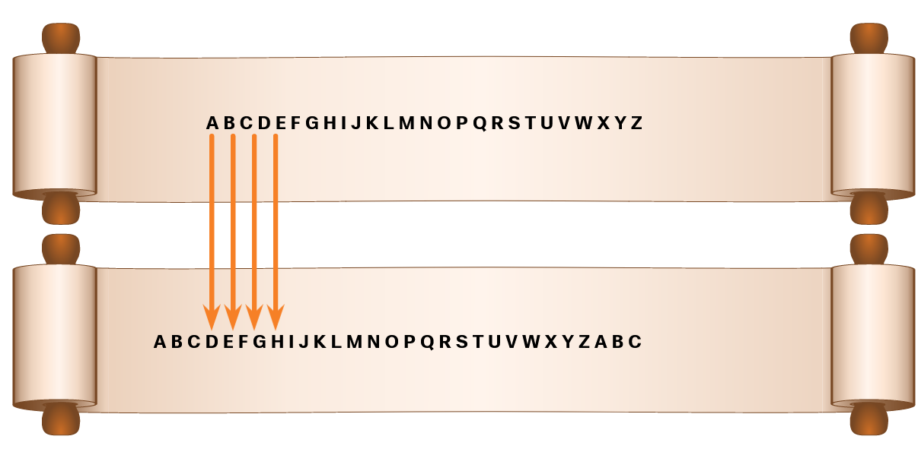
Cryptography
Substitution Ciphers
Substitution ciphers substitute one letter for another. In their simplest form, substitution ciphers retain the letter frequency of the original message.
Notes:
15: Cryptographic Services 15.2: Cryptography 15.2.3: Substitution Ciphers

Slide 21

Cryptography
A More Complex Substitution Cipher
The Vigenère cipher is based on the Caesar cipher, except that it encrypts text by using a different polyalphabetic key shift for every plaintext letter. The different key shift is identified using a shared key between sender and receiver. The plaintext message can be encrypted and decrypted using the Vigenère Cipher Table that is shown in the figure.
Notes:
15: Cryptographic Services 15.2: Cryptography 15.2.4: A More Complex Substitution Cipher

Slide 22
Cryptography
A More Complex Substitution Cipher (Cont.)
To illustrate how the Vigenère Cipher Table works, suppose that a sender and receiver have a shared secret key composed of these letters: SECRETKEY. The sender uses this secret key to encode the plaintext FLANK EAST ATTACK AT DAWN:
The F (FLANK) is encoded by looking at the intersection of column F and the row starting with S (SECRETKEY), resulting in the cipher letter X.
The L (FLANK) is encoded by looking at the intersection of column L and the row starting with E (SECRETKEY), resulting in the cipher letter P.
The A (FLANK) is encoded by looking at the intersection of column A and the row starting with C (SECRETKEY), resulting in the cipher letter C.
The N (FLANK) is encoded by looking at the intersection of column N and the row starting with R (SECRETKEY), resulting in the cipher letter E.
The K (FLANK) is encoded by looking at the intersection of column K and the row starting with E (SECRETKEY), resulting in the cipher letter O.
For example, SECRETKEYSECRETKEYSEC is required to encode FLANK EAST ATTACK AT DAWN:
Secret key: SECRETKEYSECRETKEYSEC
Plaintext: FLANKEASTATTACKATDAWN
Cipher text: XPCEOXKURSXVRGDKXBSAP
Notes:
15: Cryptographic Services 15.2: Cryptography 15.2.4: A More Complex Substitution Cipher

Slide 23
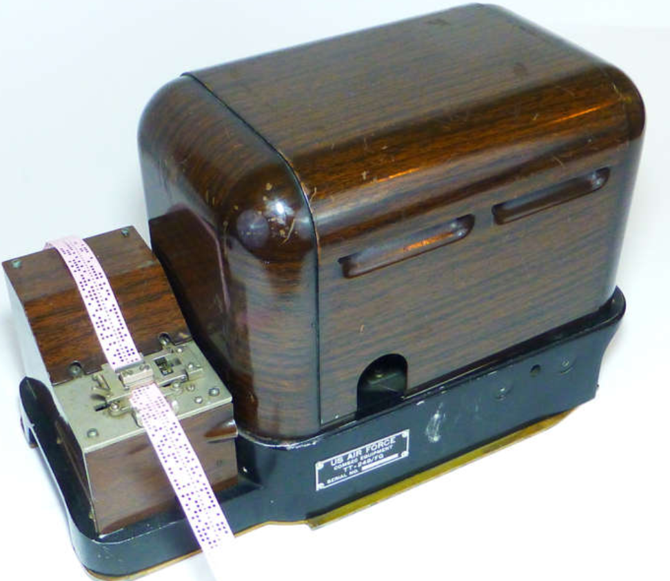
Cryptography
One-Time Pad Ciphers
Gilbert Vernam was an AT&T Bell Labs engineer who, in 1917, invented, and later patented, the stream cipher. He also co-invented the one-time pad cipher. Vernam proposed a teletype cipher in which a prepared key consisting of an arbitrarily long, non-repeating sequence of numbers was kept on paper tape, shown in the figure. It was then combined character by character with the plaintext message to produce the ciphertext.
To decipher the ciphertext, the same paper tape key was again combined character by character, producing the plaintext. Each tape was used only once; hence, the name one-time pad. Several difficulties are inherent in using one-time pads in the real world.
Notes:
15: Cryptographic Services 15.2: Cryptography 15.2.5: One-Time Pad Ciphers

Slide 24
15.3 Cryptanalysis
Notes:
15: Cryptographic Services 15.3: Cryptanalysis

Slide 25
Cryptanalysis
Cracking Code
Cryptanalysis is the practice and study of determining the meaning of encrypted information (cracking the code), without access to the shared secret key. This is also known as codebreaking.
Throughout history, there have been many instances of cryptanalysis:
The Vigenère cipher had been absolutely secure until it was broken in the 19th century by English cryptographer Charles Babbage.
Mary, Queen of Scots, was plotting to overthrow Queen Elizabeth I from the throne and sent encrypted messages to her co-conspirators. The cracking of the code used in this plot led to the beheading of Mary in 1587.
The Enigma-encrypted communications were used by the Germans to navigate and direct their U-boats in the Atlantic. Polish and British cryptanalysts broke the German Enigma code. Winston Churchill was of the opinion that it was a turning point in WWII.
Notes:
15: Cryptographic Services 15.3: Cryptanalysis 15.3.1: Cracking Code

Slide 26
Cryptanalysis
Methods of Cracking Code
Several methods are used in cryptanalysis:
Brute-force method - The attacker tries every possible key knowing that eventually one of them will work.
Ciphertext method - The attacker has the ciphertext of several encrypted messages but no knowledge of the underlying plaintext.
Known-Plaintext method - The attacker has access to the ciphertext of several messages and knows something about the plaintext underlying that ciphertext.
Chosen-Plaintext method - The attacker chooses which data the encryption device encrypts and observes the ciphertext output.
Chosen-Ciphertext method - The attacker can choose different ciphertext to be decrypted and has access to the decrypted plaintext.
Meet-in-the-Middle method - The attacker knows a portion of the plaintext and the corresponding ciphertext.
Notes:
15: Cryptographic Services 15.3: Cryptanalysis 15.3.2: Methods of Cracking Code

Slide 27
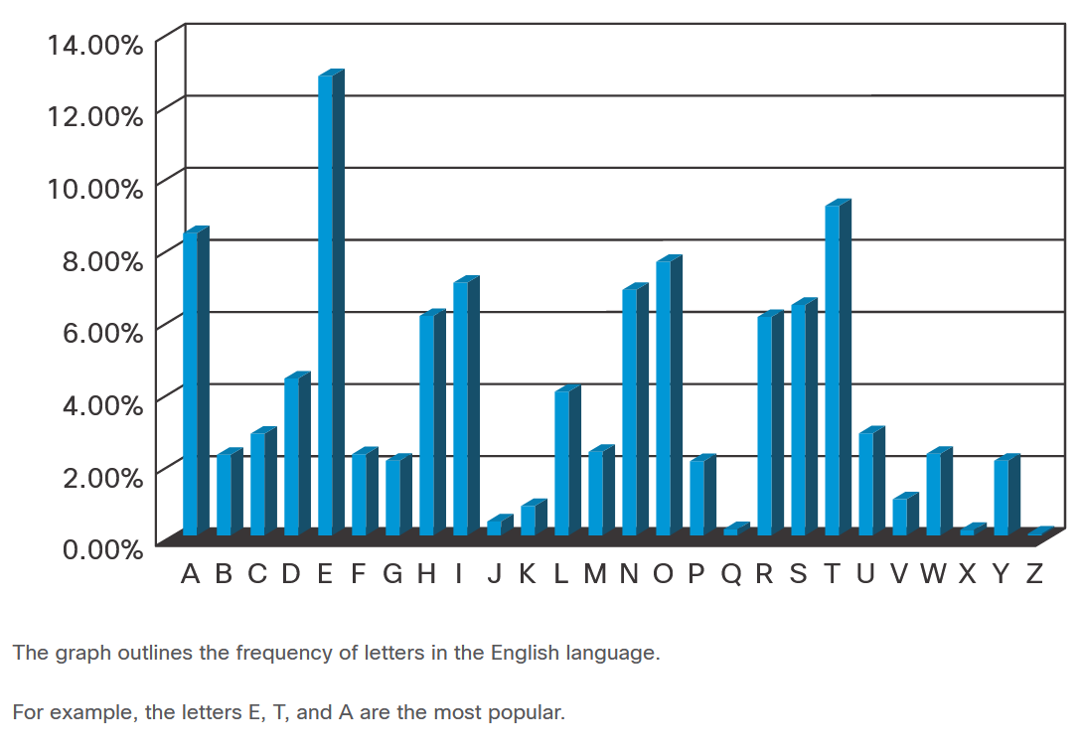
Cryptanalysis
Cracking Code Example
When choosing a cryptanalysis method, consider the Caesar cipher encrypted code. The best way to crack the code is to use brute force. Because there are only 25 possible rotations, the effort is relatively small to try all possible rotations and see which one returns something that makes sense.
A more scientific approach is to use the fact that some characters in the English alphabet are used more often than others. This method is called frequency analysis.
Notes:
15: Cryptographic Services 15.3: Cryptanalysis 15.3.3: Cracking Code Example
15.3.4: Check your Understanding- Crack the Code

Slide 28
15.4 Cryptology
Notes:
15: Cryptographic Services 15.4: Cryptology

Slide 29
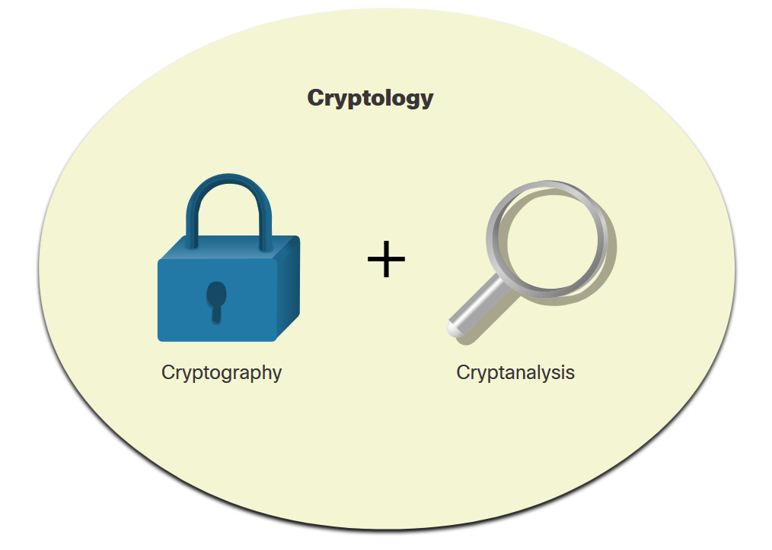
Cryptology
Making and Breaking Secret Codes
Cryptology is the science of making and breaking secret codes. As shown in the figure, cryptology combines two separate disciplines:
Cryptography - the development and use of codes
Cryptanalysis - the breaking of those codes
There is a symbiotic relationship between the two disciplines because each makes the other one stronger. National security organizations employ practitioners of both disciplines and put them to work against each other.
Notes:
15: Cryptographic Services 15.4: Cryptology 15.4.1: Making and Breaking Secret Codes

Slide 30
Cryptology
Cryptanalysts
Cryptanalysis is often used by governments in military and diplomatic surveillance, by enterprises in testing the strength of security procedures, and by malicious hackers in exploiting weaknesses in websites.
Cryptanalysts are individuals who perform cryptanalysis to crack secret codes. A sample job description is displayed in the figure.
While cryptanalysis is often linked to mischievous purposes, it is actually a necessity. It is an ironic fact of cryptography that it is impossible to prove that any algorithm is secure. It can only be proven that it is not vulnerable to known cryptanalytic attacks. Therefore, there is a need for mathematicians, scholars, and security forensic experts to keep trying to break the encryption methods.
Notes:
15: Cryptographic Services 15.4: Cryptology 15.4.2: Cryptanalysts

Slide 31
Cryptology
The Secret is in the Keys
In the world of communications and networking, authentication, integrity, and data confidentiality are implemented in many ways using various protocols and algorithms. The choice of protocol and algorithm varies based on the level of security required to meet the goals of the network security policy.
The table lists some common cryptographic hashes, protocols, and algorithms.
Integrity | Authenticity | Confidentiality
MD5 (legacy) | HMAC-MD5 (legacy) | 3DES (legacy)
SHA | HMAC-SHA-256 | AES
 | RSA and DSA
Notes:
15: Cryptographic Services 15.4: Cryptology 15.4.3: The Secret is in the Keys
15.4.4: Check Your Understanding - Cryptology Terminology

Slide 32
Cryptology
Lab - Exploring Encryption Methods
In this lab, you will complete the following objectives:
Part 1: Decipher a pre-encrypted message using the Vigenère cipher.
Part 2: Create a Vigenère cipher encrypted message and decrypt it.
Notes:
15: Cryptographic Services 15.4: Cryptology 15.4.5: Lab - Exploring Encryption Methods

Slide 33
15.5 Cryptographic Services - Summary
Notes:
15: Cryptographic Services 15.5: Cryptographic Services - Summary

Slide 34
Cryptographic Services - Summary
What Did I Learn in this Module?
The three primary objectives of securing communications are authentication, integrity, and confidentiality.
Authentication may be secured by HMAC.
Integrity is ensured through the use of the SHA family of hash generating algorithms.
Data confidentiality is ensured through symmetric encryption algorithms, such as AES, and asymmetric algorithms, such RSA and PKI.
Authentication proves that a message actually comes from a valid source.
Data nonrepudiation is a similar service to authentication in that it allows the sender of a message to be uniquely identified.
Data integrity ensures that messages are not altered in transit.
Data confidentiality ensures privacy so that only the intended receiver can read the message.
Three types of cipher are transposition, substitution, and one-time pad
Cryptanalysis, or codebreaking, is the practice and study of determining the meaning of encrypted information (cracking the code), without access to the shared secret key.
Notes:
15: Cryptographic Services 15.5: Cryptographic Services - Summary 15.5.1: What Did I Learn in this Module?

Slide 35
Cryptographic Services - Summary
What Did I Learn in this Module? (Cont.)
The objective of modern cryptographers is to have a keyspace large enough that it takes too much time and money to accomplish a brute-force attack.
Cryptology is the science of making and breaking secret codes. It combines cryptography and cryptanalysis.
The choice of algorithm varies depending on the security requirements, the hardware resources that are available for encryption and decryption, and the acceptance of the algorithm in the security community.
With most modern algorithms, the security of encryption lies in the secrecy of the keys, not the algorithm.
Notes:
15: Cryptographic Services 15.5: Cryptographic Services - Summary 15.5.1: What Did I Learn in this Module?
15.5.2: Module Quiz

Slide 36
Cryptographic Services
New Terms and Commands
data integrity data confidentiality Caesar cipher scytale Vigenère cipher Enigma machine transposition ciphers block cipher substitution cipher one-time pad cipher brute-force method ciphertext method known-plaintext method chosen-plaintext method chosen-ciphertext method | meet-in-the-middle method cryptology cryptography cryptanalysis
Notes:
15: Cryptographic Services
New Terms and Commands

